Slide 1


My Gym Bro
Juan Manuel Saavedra Alquézar
2º Desarrollo de Aplicaciones Multiplataforma
20 de junio 2022

Slide 2



Índice
Origen
Requisitos
Problemas
Futuro
Herramientas
Cambios en el proceso
Conclusiones

Slide 3




Introducción

Slide 4

Origen

Slide 5



Observación
Falta de competencia
Cuadernos

Slide 6

Con una excepción:

Slide 7
Requisitos

Slide 8
Registrar rutinas, entrenos y PR
Mostrar graficas de avances
Agregar amigos para poder ver sus progresos
Tener un login que guarde usuarios para que si inicias desde otro dispositivo tengas tus progresos y tus rutinas guardadas
Agregar, tu peso, tu altura y el volumen de tus músculos para ver como has ido ‘creciendo’.
Revisar que están haciendo tus amigos y cuáles son sus Pr

Slide 9
Problemas

Slide 10
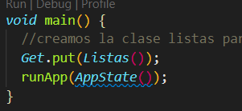
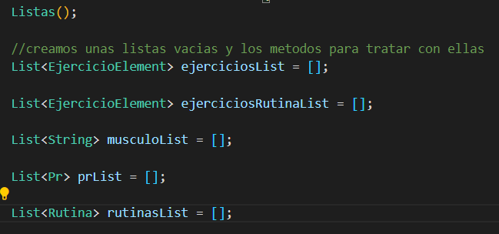

Acceder a listas desde cualquier pantalla

Slide 11
Rellenar el Dropdownbutton

Slide 12
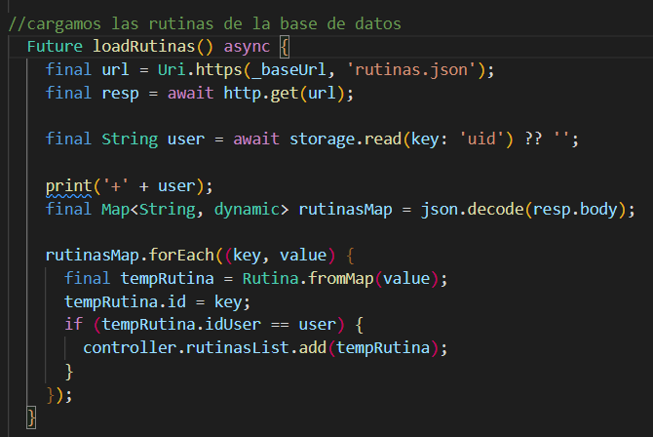
Diferenciar las rutinas obtenidas de la base de datos

Slide 13
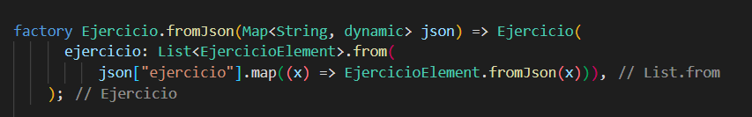
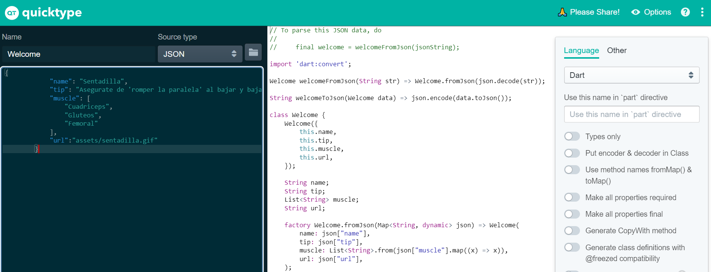
Convertir las rutinas obtenidas

Slide 14
Futuro

Slide 15

Crear Graficas de progresos

Slide 16

Agregar amigos

Slide 17
Herramientas

Slide 18




Team
Name
Name
Name
Name
Title
Title
Title
Title

Slide 19
Timeline
Title
To start a presentation, go to the Slide Show tab, and select From Beginning.
Title
To display Presenter view, in Slide Show view, on the control bar at the bottom left select the three dots, and then Show Presenter View.
Title
During your presentation, the speaker notes are visible on your monitor, but aren't visible to the audience.
Title
Title
If you don’t see the Notes pane or it is completely minimized, click Notes on the task bar across the bottom of the PowerPoint window.
The Notes pane is a box that appears below each slide. Tap it to add notes.

Slide 20
Content
Subtitle
Subtitle
Add text, images, art, and videos.
Add transitions, animations, and motion.
Save to OneDrive, to get to your presentations from your computer, tablet, or phone.
Open the Design Ideas pane for instant slide makeovers.
When we have design ideas, we’ll show them to you right there.

Slide 21
Content 2
Subtitle
subtitle
subtitle
Add text, images, art, and videos.
Add transitions, animations, and motion.
Save to OneDrive, to get to your presentations from your computer, tablet, or phone.
Open the Design Ideas pane for instant slide makeovers.
When we have design ideas, we’ll show them to you right there.
Add text, images, art, and videos.
Add transitions, animations, and motion.
Save to OneDrive, to get to your presentations from your computer, tablet, or phone.
Open the Design Ideas pane for instant slide makeovers.
When we have design ideas, we’ll show them to you right there.
Add text, images, art, and videos.
Add transitions, animations, and motion.
Save to OneDrive, to get to your presentations from your computer, tablet, or phone.
Open the Design Ideas pane for instant slide makeovers.
When we have design ideas, we’ll show them to you right there.

Slide 22

Summary
With PowerPoint, you can create presentations and share your work with others, wherever they are. Type the text you want here to get started. You can also add images, art, and videos on this template. Save to OneDrive and access your presentations from your computer, tablet, or phone.

Slide 23


Thank You
Presenter name
Email address
Website address

